Slide 1
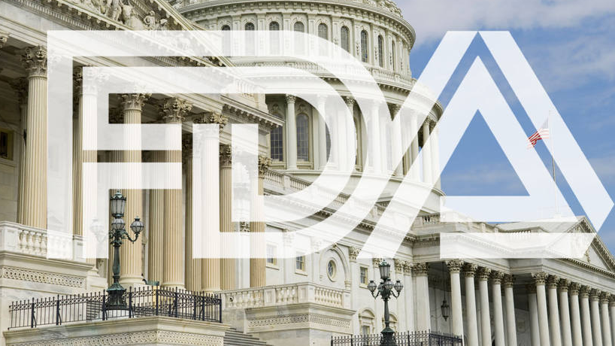
OneScan
https://www.cigaraficionado.com/article/lobbyists-increase-outreach-for-premium-cigar-exemption-19574

Slide 2

ENGG6400 Mobile Devices App Development
Group 5 Zimo Zhou (1189792), Yaowen Mei (1177855)

Slide 3
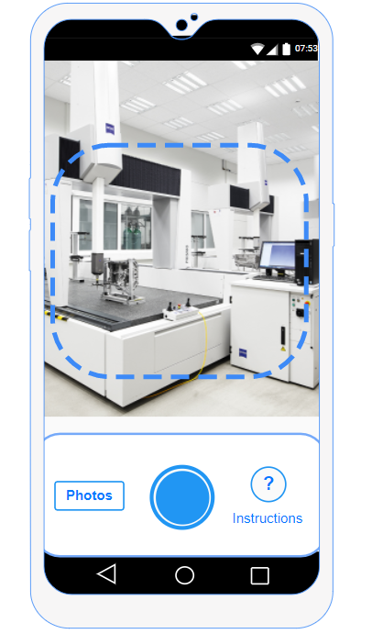
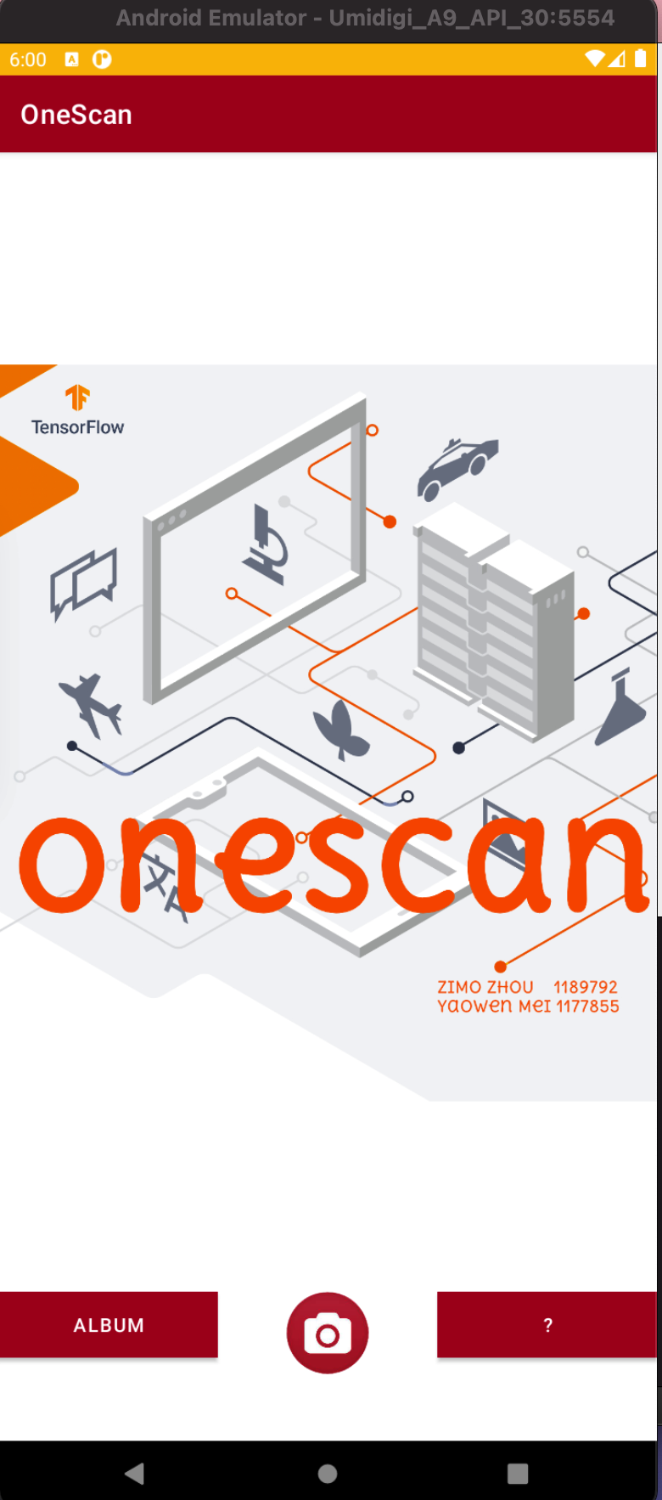
Mock-up vs Real
--- Home Screen
User can take a picture with this app
Or choose a photo from the album
Or see the instructions about how the app is going to work
3
1
2

Slide 4
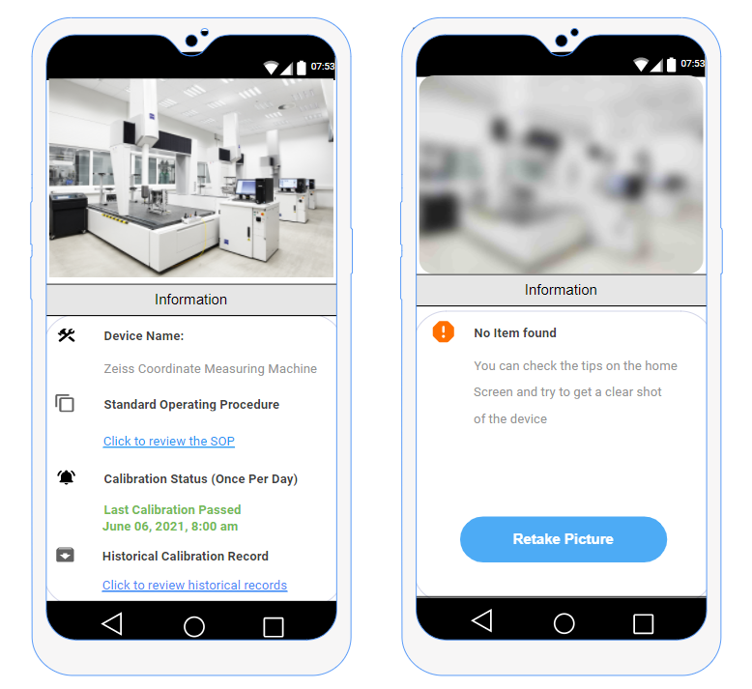
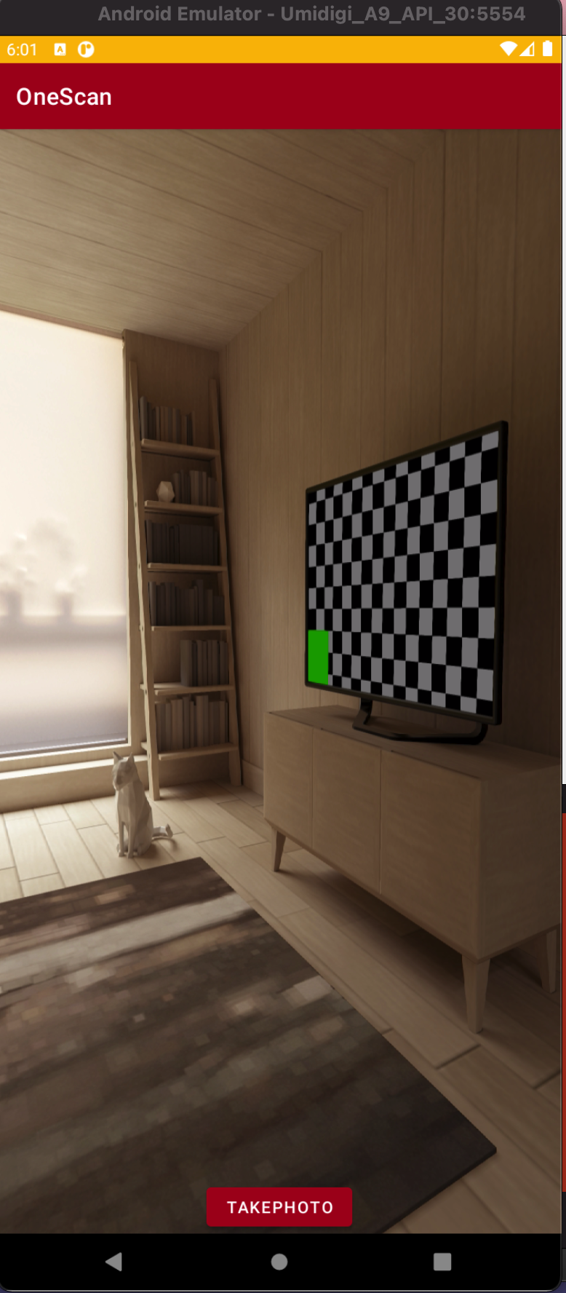
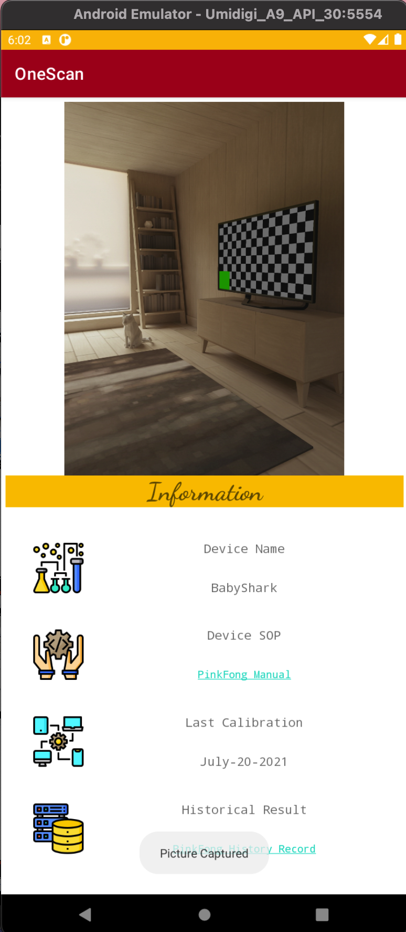
Mock-up vs Real
--- 1) Take a picture
If the device is recognized, the calibration information of this device will then be generated from the data base. Green for good to use, Red for out of calibration
If the picture is blurry, device can not be recognized, an error message will be generated, so user can retake the picture

Slide 5
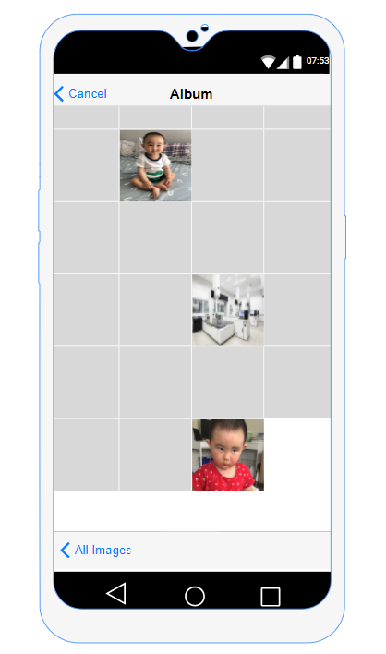
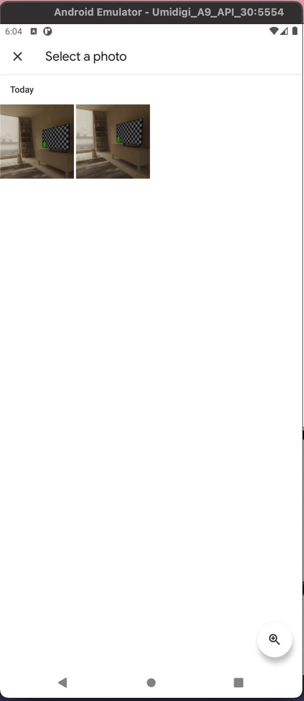
Mock-up vs Real
--- 2) Select from Album
User can also take pictures from the album

Slide 6
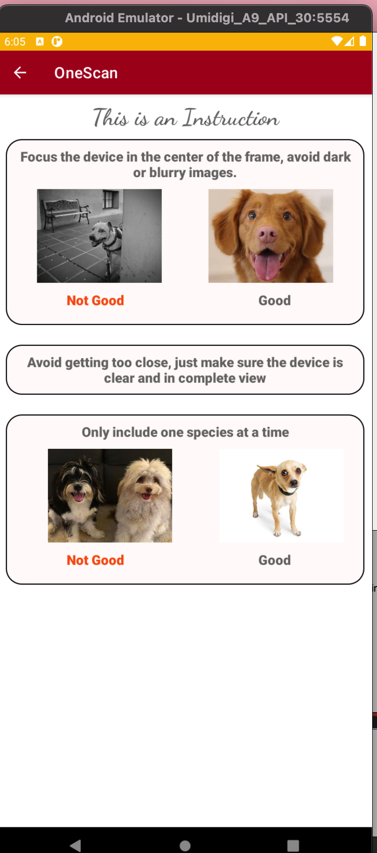
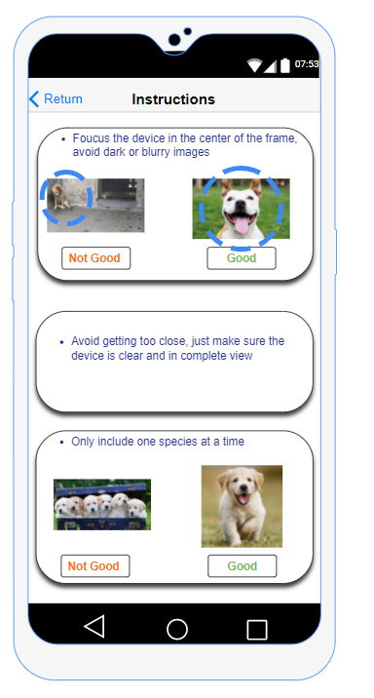
Mock-up vs Real
--- 3) Instruction
The user should be able to use this app by intuition, but just in case, some instructions are aslo provided for the user:
Focus and put target in the center
Only picture one object at a time

Slide 7
Block Diagram
Home Screen
2
3
1
Select Image from Album
Take a picture
Show Instruction
Recognized by ML
Not a Learned Device
Yes
Check Connection to DB
No
Only show Name
Yes
Show Details from DB

Slide 8
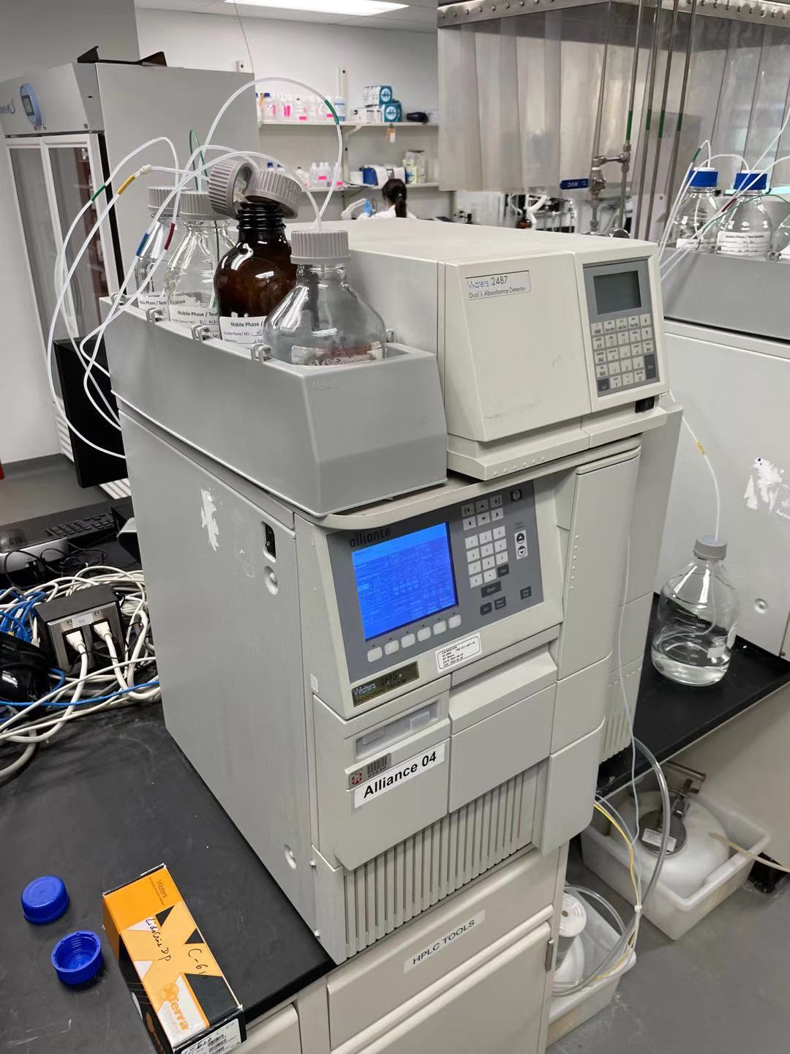
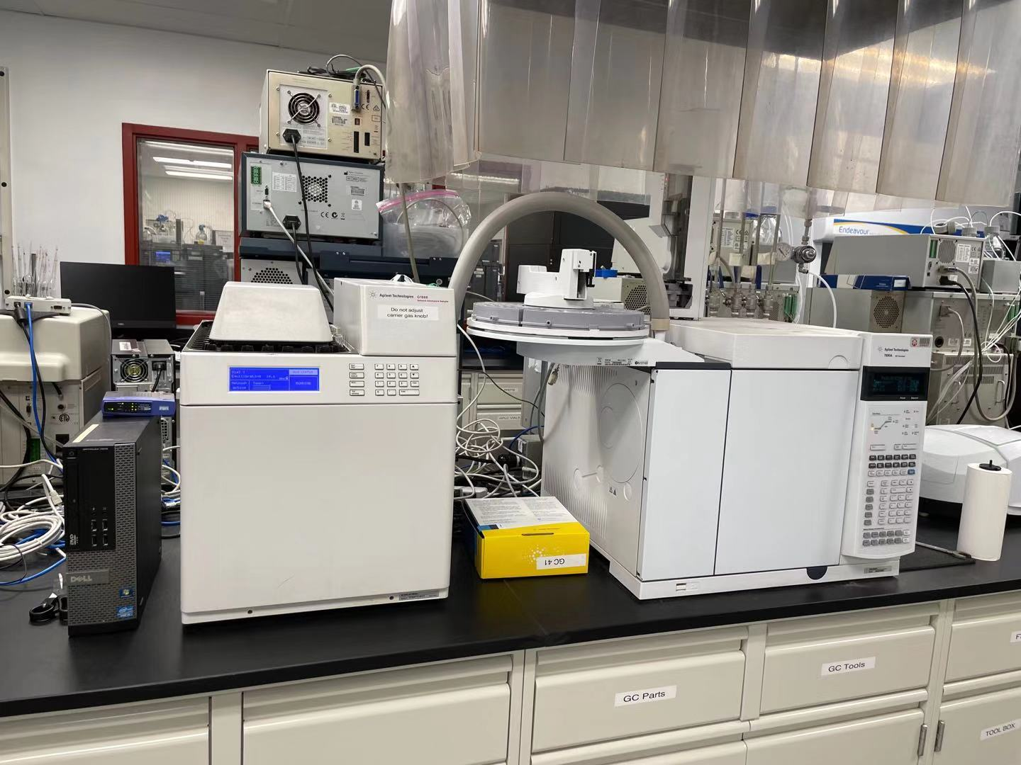
Analytical Chemistry 101
Gas_Chromatography (GC)
High-Performance Liquid Chromatography-(HPLC)
https://en.wikipedia.org/wiki/High-performance_liquid_chromatography
https://en.wikipedia.org/wiki/Gas_chromatography

Slide 9
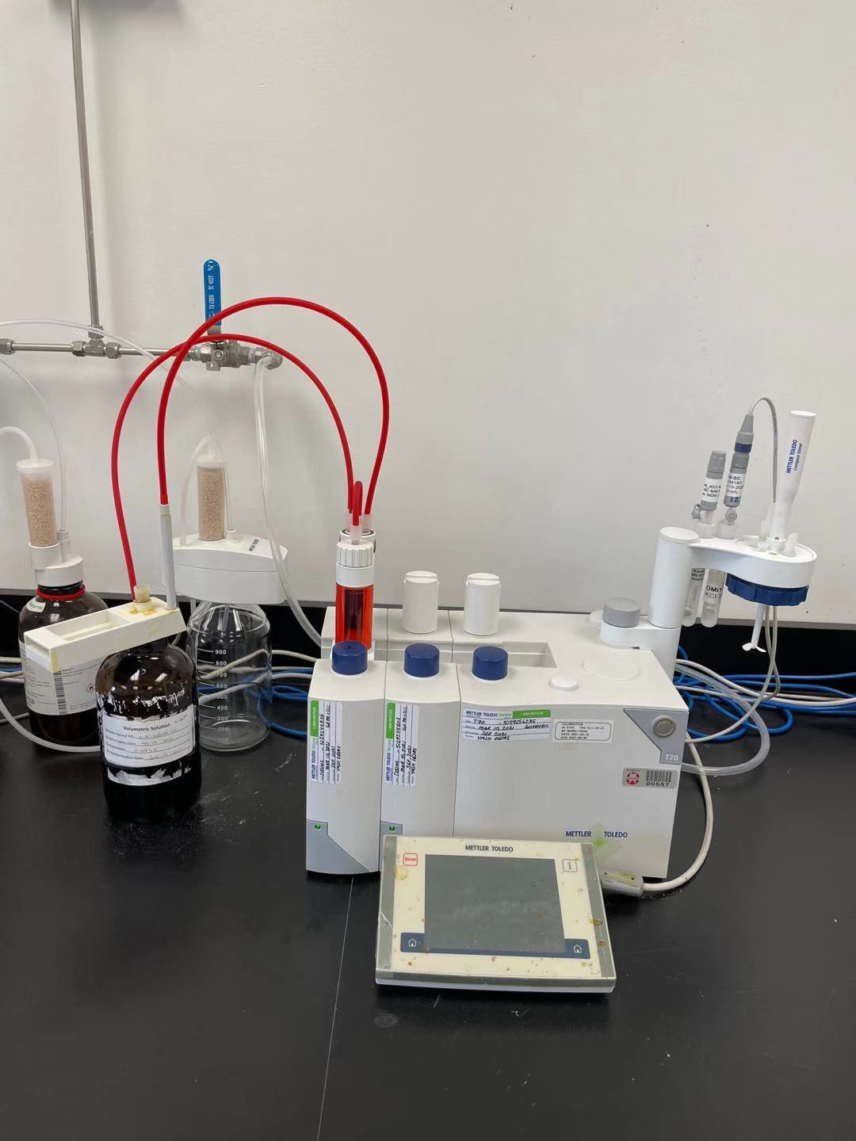
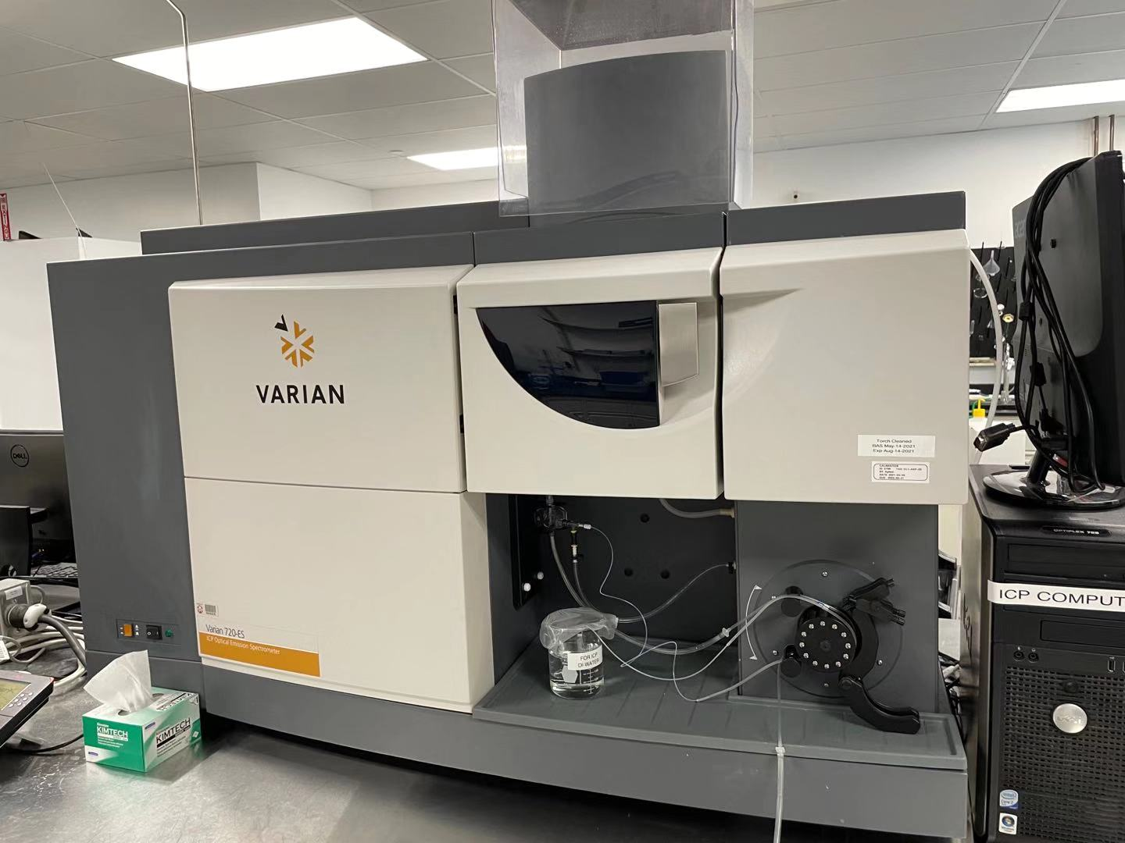
Analytical Chemistry 101
Autotitrator
Inductively Coupled Plasma (ICP)-atomic emission spectrometry
https://www.sciencedirect.com/topics/materials-science/inductively-coupled-plasma-atomic-emission-spectroscopy
https://en.wikipedia.org/wiki/Titration

Slide 10
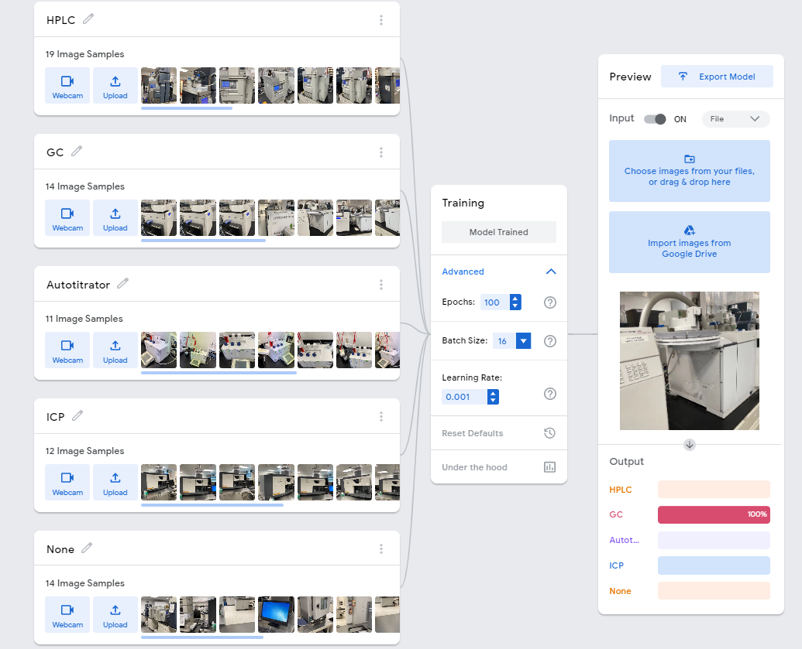

Slide 11
The End. Thank you!

